Slide 1
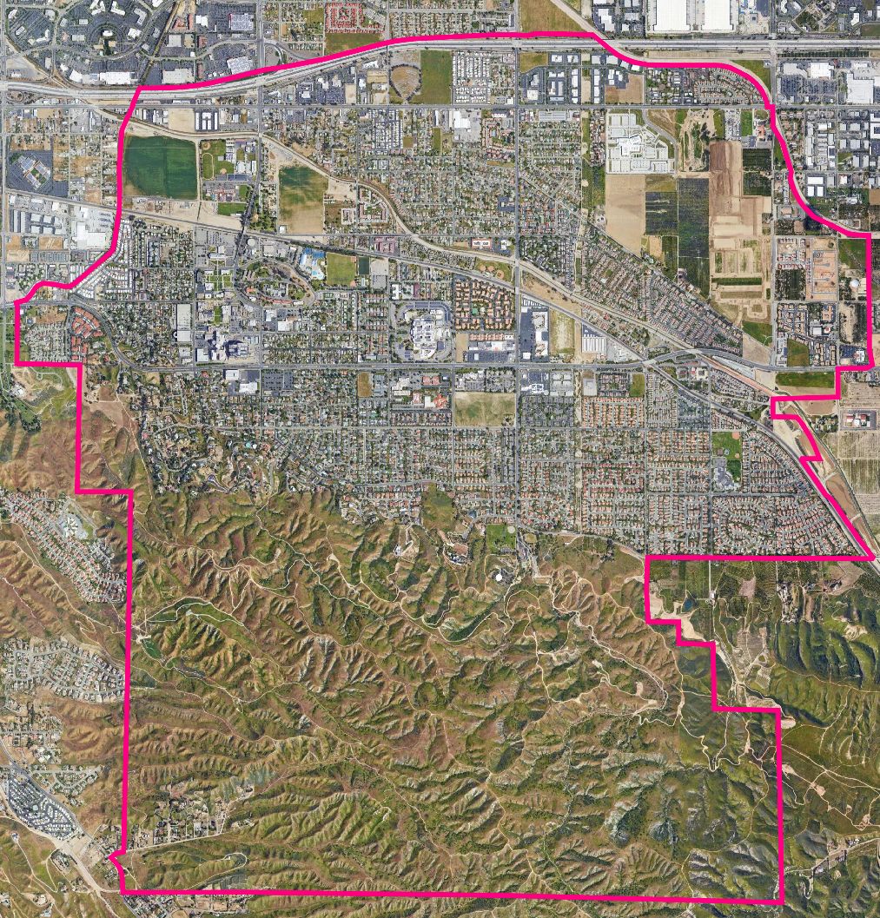
City of Loma Linda Introduction to Districting
Dr. Douglas Johnson, NDC
Dr. Justin Levitt, NDC
National Demographics Corporation

Slide 2
Districting Process
Step | Description
Two Initial Hearings August 9 & Sept 6, 2022 | Held prior to release of draft maps. Education and to solicit input on the composition of districts.
Deadline for Map Submission Sept. 29, 2022 | Maps from members of the community must be received by September 29th.
Draft Maps Released Oct. 4, 2022 | Maps must be posted 7 days in advance of Public Hearing 3
Two hearings on draft maps Oct. 11 & Oct. 25, 2022 | Two meetings to discuss and revise the draft maps and to discuss the election sequence. There will be an additional chance for the community to submit maps before Public Hearings 4 and 5
Map adoption Nov. 8, 2022 | Map adopted via ordinance. Final map must be posted at least 7 days prior to adoption.

Slide 3
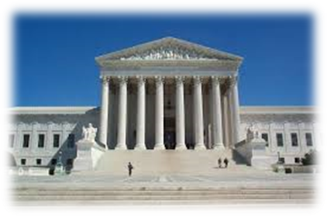
Redistricting Rules and Goals
1. Federal Laws
2. California Criteria for Cities
3. Other Traditional Redistricting Principles
Equal Population
Federal Voting Rights Act
No Racial Gerrymandering
Geographically contiguous
Undivided neighborhoods and “communities of interest” (Socio-economic geographic areas that should be kept together)
Easily identifiable boundaries
Compact (Do not bypass one group of people to get to a more distant group of people)
Prohibited:
“Shall not favor or discriminate against a political party.”
Respect voters’ choices / continuity in office
Future population growth

Slide 4
Draft Maps Overview
To date, the City has received nine full five-district maps from the community
These are numbered Maps 101 through 109
6 fail to meet legal requirements
2 are not population-balanced or contiguous
4 are not population-balanced
NDC added three maps to the conversation
110, 111, and 112

Slide 5
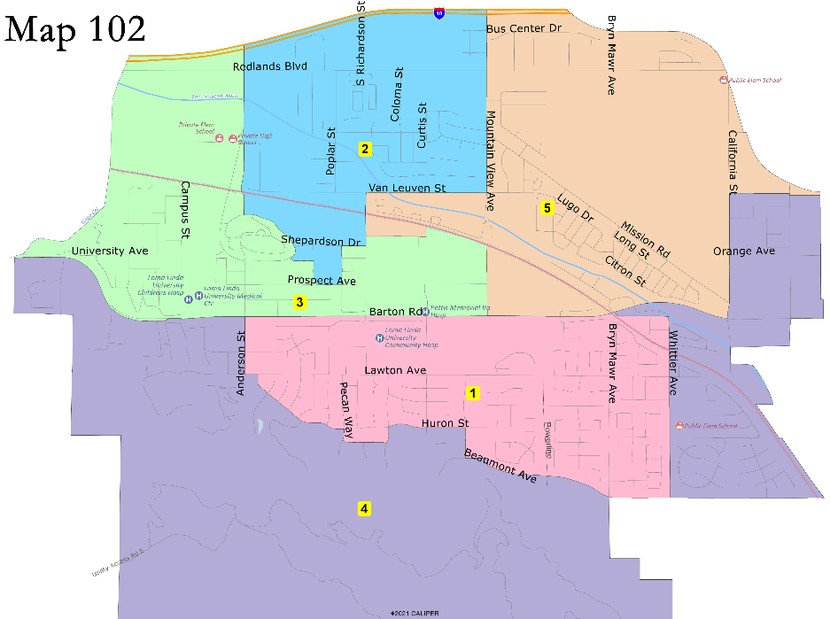
Not population-balanced or contiguous

Slide 6
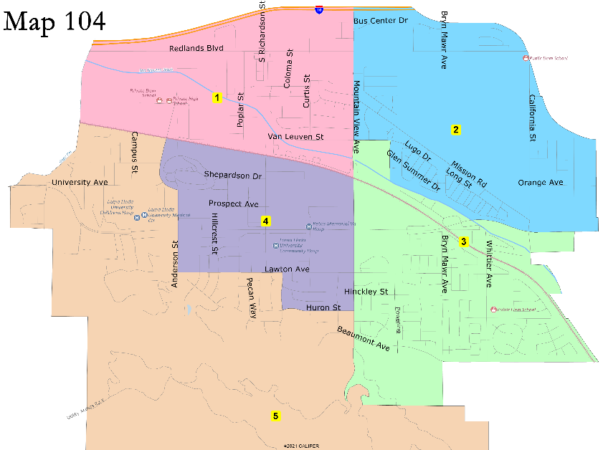
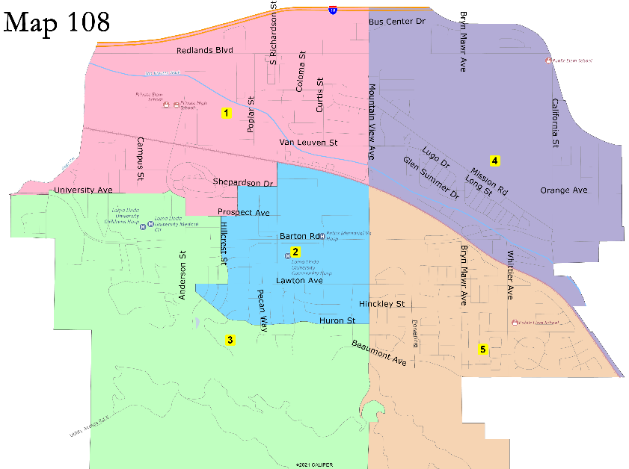
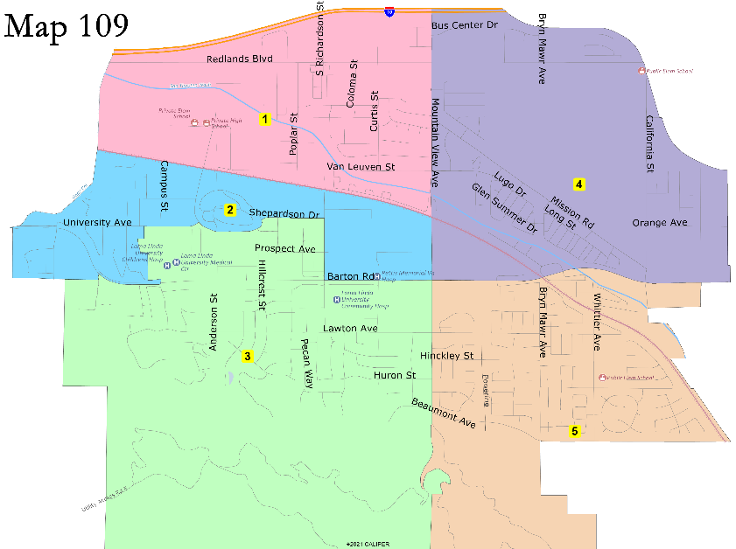
Not population-balanced
12.7% deviation
26.1% deviation
95% deviation
21% deviation

Slide 7
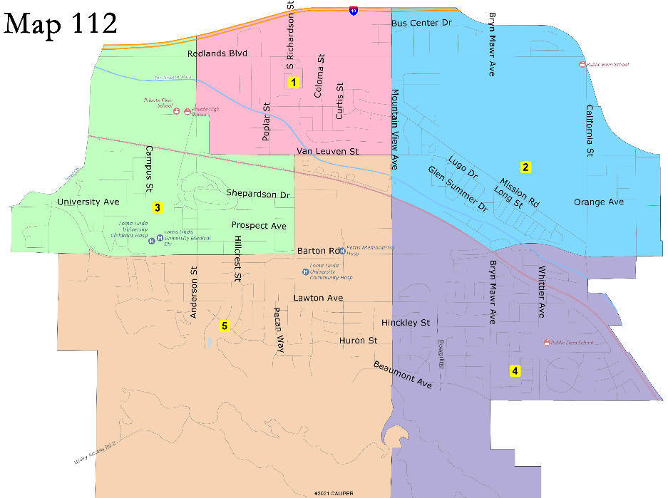
D1 between Mountain View and Anderson
Sequence of Elections:
D1 – 2024
D2 – 2024 or 2026
D3 – 2024
D4 – 2026
D5 – 2024 or 2026
Sequence of Elections:
D1 – 2024
D2 – 2026
D3 – 2024 or 2026
D4 – 2024 or 2026
D5 – 2024

Slide 8
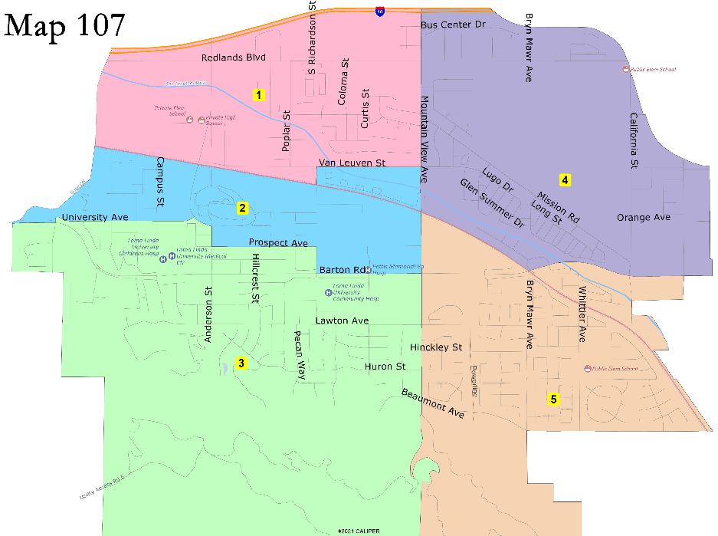
D1 follows railway
Sequence of Elections:
D1 – 2024
D2 – 2024 or 2026
D3 – 2024
D4 – 2026
D5 – 2024 or 2026
Sequence of Elections:
D1 – 2024
D2 – 2024 or 2026
D3 – 2024
D4 – 2026
D5 – 2024 or 2026

Slide 9
Map 110
Sequence of Elections:
D1 – 2024
D2 – 2026
D3 – 2026
D4 – 2024
D5 – 2024

Slide 10
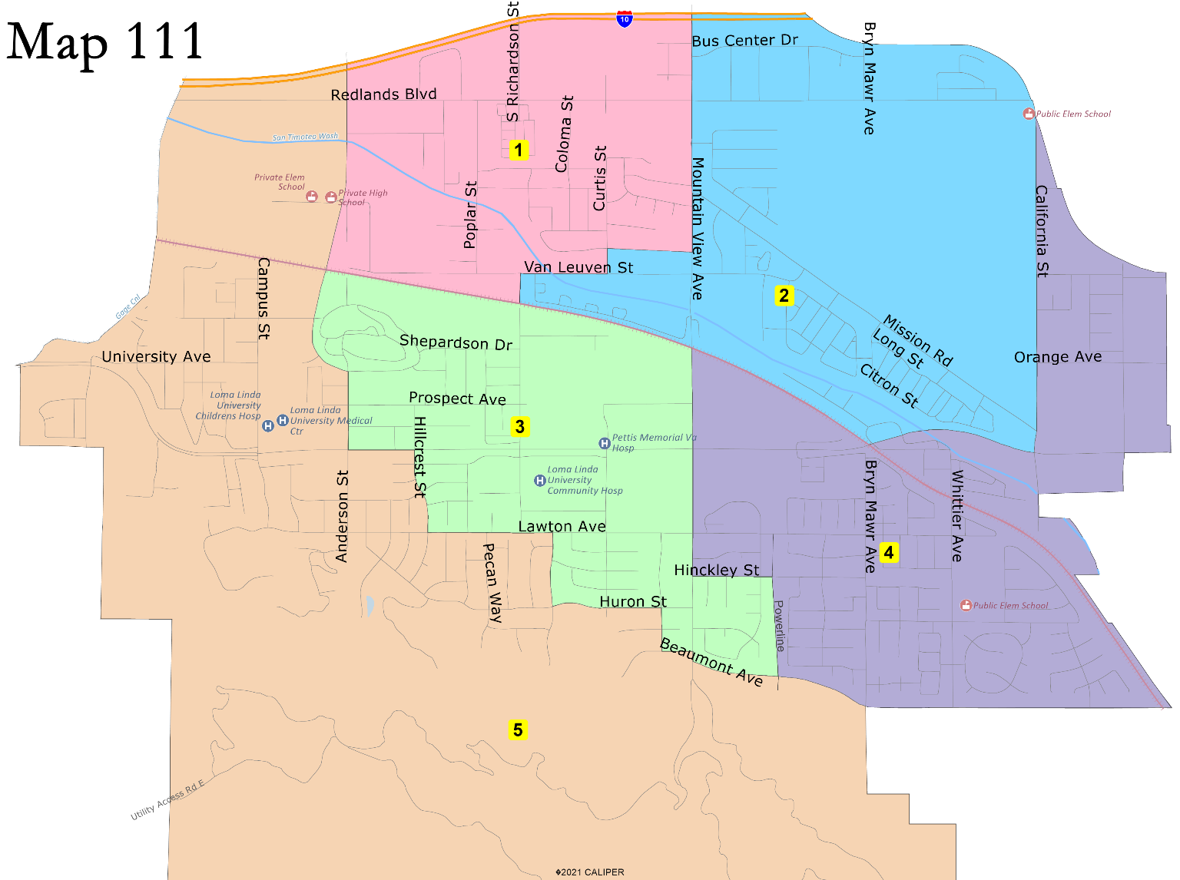
Map 111
Sequence of Elections:
D1 – 2024
D2 – 2026
D3 – 2026
D4 – 2024
D5 – 2024

Slide 11
Public Hearing & Discussion
What do you like about the different draft maps?
Which draft map(s) best comply with the Fair Maps Act criteria?
What changes do you want NDC to bring back for the next hearing?
Any questions about the mapping tools?
Discussion:
Selection of 2-3 “Focus” maps
Requests for changes to the October 24th Hearing

Slide 12
Share Your Thoughts
Website
https://drawlomalinda.org/
Phone
T Jarb Thaipejr, City Manager, 909-799-2811
Lynette Arreola, City Clerk, 909-799-2819
Email
CVRA-Dist.based.elect@lomalinda-ca.gov

