Slide 1
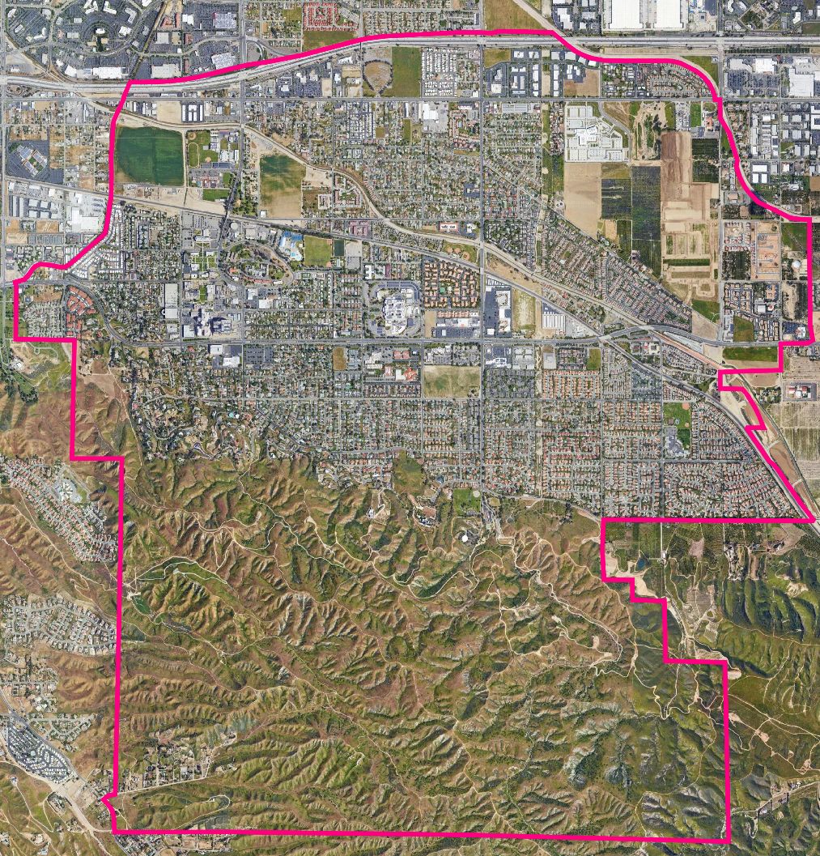
City of Loma Linda Draft Plan Presentation
Dr. Douglas Johnson, NDC
Dr. Justin Levitt, NDC
National Demographics Corporation

Slide 2
Districting Process
Step | Description
Two Initial Hearings August 9 & Sept 6, 2022 | Held prior to release of draft maps. Education and to solicit input on the composition of districts.
Deadline for Map Submission Sept. 29, 2022 | Maps from members of the community must be received by September 29th.
Draft Maps Released Oct. 4, 2022 | Maps must be posted 7 days in advance of Public Hearing 3
Two hearings on draft maps Oct. 11 & Oct. 25, 2022 | Two meetings to discuss and revise the draft maps and to discuss the election sequence. There will be an additional chance for the community to submit maps before Public Hearings 4 and 5
Map adoption Nov. 8, 2022 | Map adopted via ordinance. Final map must be posted at least 7 days prior to adoption.

Slide 3
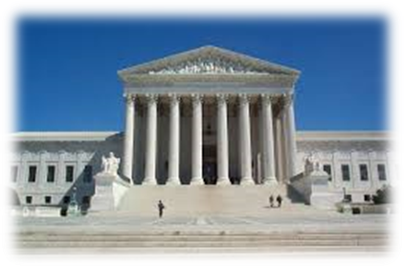
Redistricting Rules and Goals
1. Federal Laws
2. California Criteria for Cities
3. Other Traditional Redistricting Principles
Equal Population
Federal Voting Rights Act
No Racial Gerrymandering
Geographically contiguous
Undivided neighborhoods and “communities of interest” (Socio-economic geographic areas that should be kept together)
Easily identifiable boundaries
Compact (Do not bypass one group of people to get to a more distant group of people)
Prohibited:
“Shall not favor or discriminate against a political party.”
Respect voters’ choices / continuity in office
Future population growth

Slide 4
Draft Maps Overview
On October 11, the Council designated Maps 110, 111, and 112 as “Focus Maps”
12 maps were considered, including nine from the community
Six failed to meet legal requirements of population-balance or contiguity
No new maps were received prior to this meeting

Slide 5
Map 110
Sequence of Elections:
D1 – 2024
D2 – 2026
D3 – 2026
D4 – 2024
D5 – 2024

Slide 6
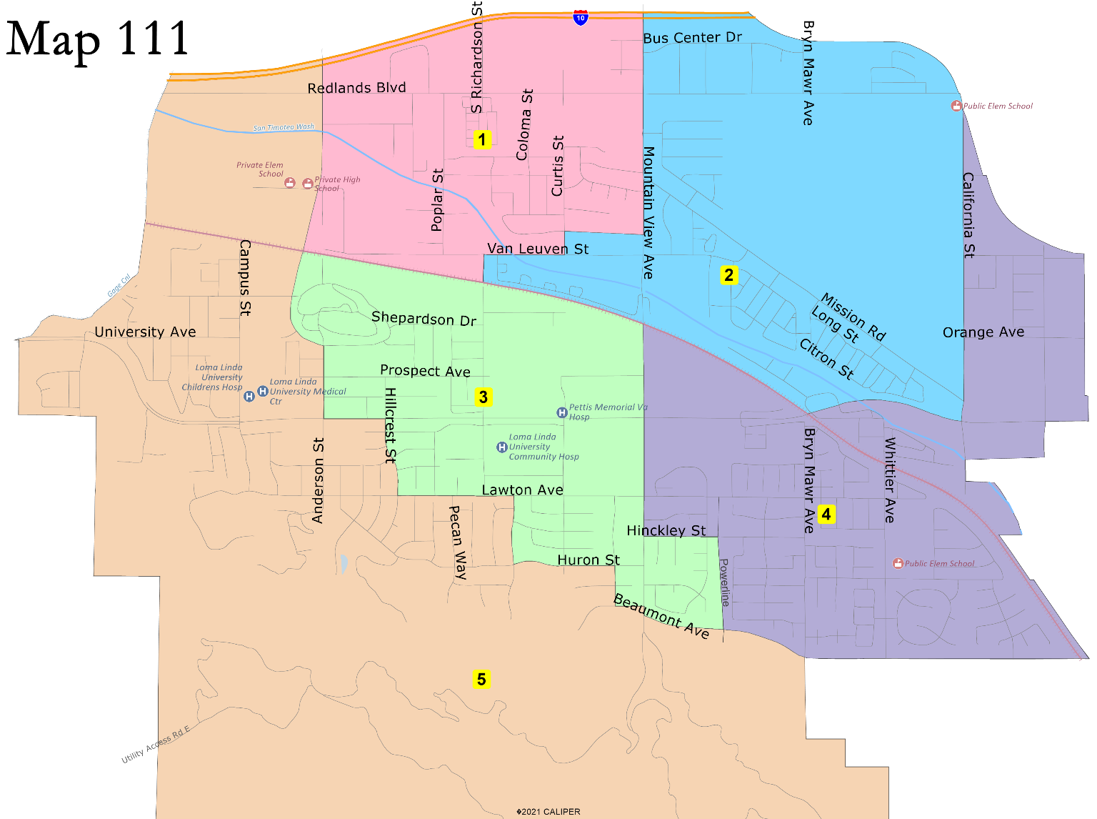
Map 111
Sequence of Elections:
D1 – 2024
D2 – 2026
D3 – 2026
D4 – 2024
D5 – 2024

Slide 7
Map 112
Sequence of Elections:
D1 – 2024
D2 – 2026
D3 – 2024 or 2026
D4 – 2024 or 2026
D5 – 2024

Slide 8
Public Hearing & Discussion
What do you like about the different draft maps?
Which draft map(s) best comply with the Fair Maps Act criteria?
Which map will serve Loma Linda best over the next decade?
Discussion:
Selection of a final map

Slide 9
Share Your Thoughts
Website
https://drawlomalinda.org/
Phone
T Jarb Thaipejr, City Manager, 909-799-2811
Lynette Arreola, City Clerk, 909-799-2819
Email
CVRA-Dist.based.elect@lomalinda-ca.gov

